Slide 1


Titolo presentazione sottotitolo
TECHNOLOGIES FOR SENSORS AND CLINICAL INSTRUMENTATION AA 2022-2023
Milano, XX mese 20XX
Project: Development of a plant assist system
Marta Albini
Fabiola Dassi
Chiara Gentile
Giulia Giorgiani
Valeria Marini
Mohamed Khaled Shala

Slide 2
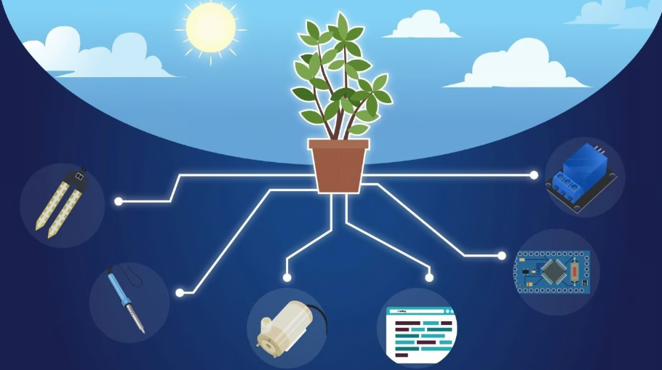
Index
Project Summary
Automatized Lighting
01
04
02
Hardware
05
3-D Structure
Software
Future Perspectives
03
06
1

Slide 3
Development of a Plant Assist System
01
Project Summary

Slide 4
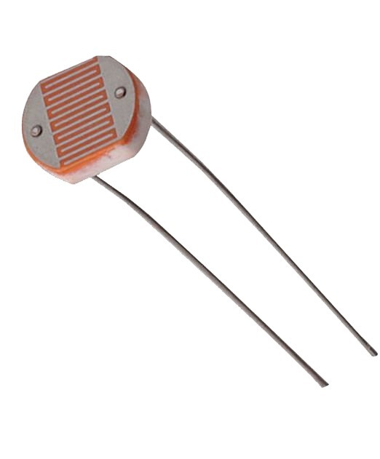
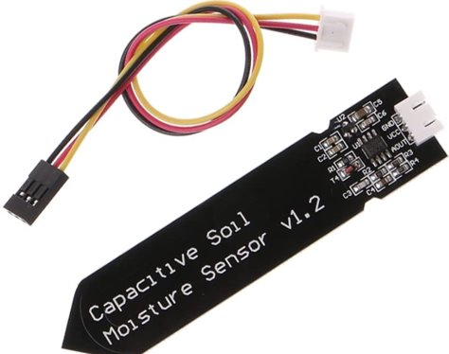
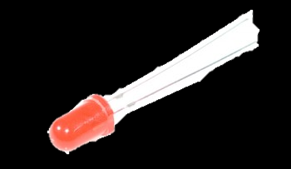
Project Summary
LDR sensor to measure the light that is received during the day
Conditioning circuit for LDR sensor
Moisture sensor
(already conditioned) to measure
the humidity level of the soil
Artificial LED lighting activated according to necessity
Small indoor plant
2

Slide 5

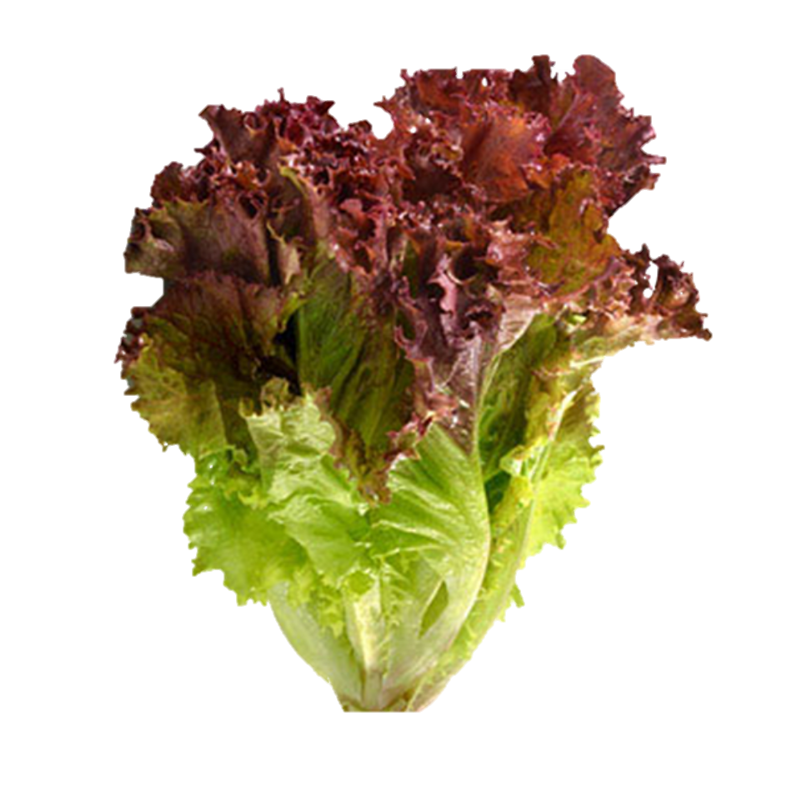


Project Summary
RED LETTUCE
Small indoor plant:
7’000 lux
For 10-12 hours a day
Plant Specifics:
8’000 – 12’000 lux
for 10-12 hours/day
moist and humid soil all the time
700
Moisture value for dry soil
AIM OF THE PROJECT:
Create a digitalized support system with a graphic interface and actuators
3

Slide 6
Development of a Plant Assist System
02
Hardware

Slide 7
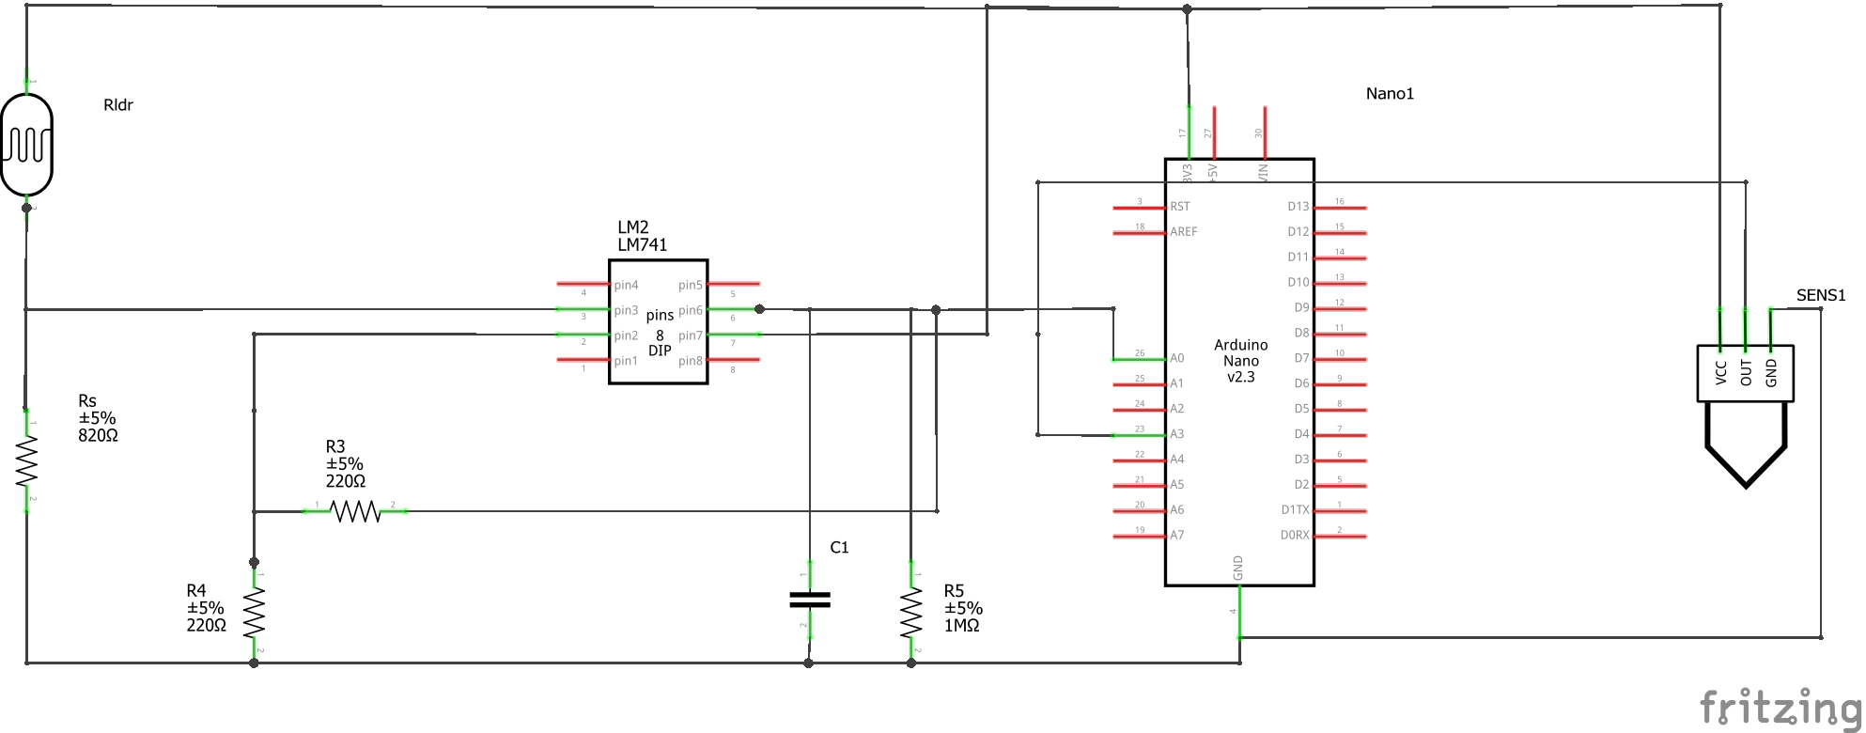
Hardware – Schematics
4

Slide 8
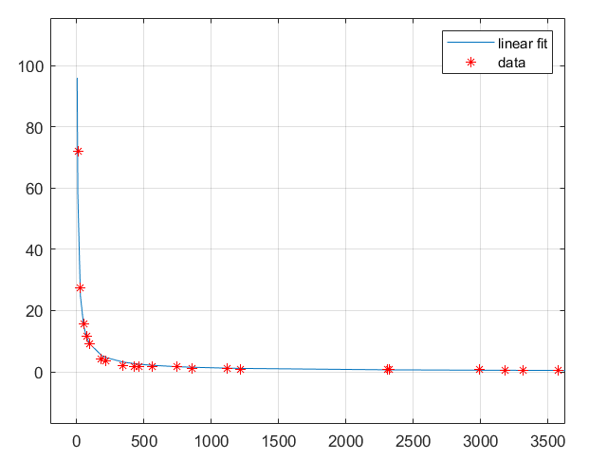
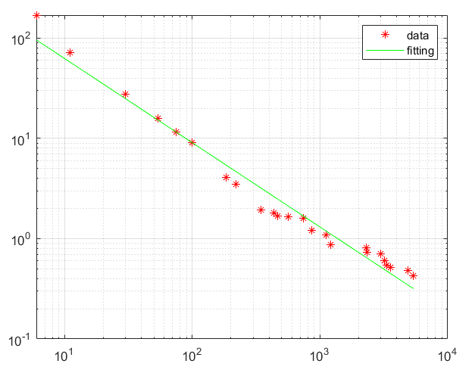
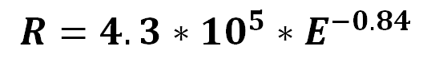
Hardware – Schematics
LDR
$$R=4.3∗{10}^{5}∗E^{−0.84}$$
Exponential curve
Loglog plot
R
R
E
E
5

Slide 9
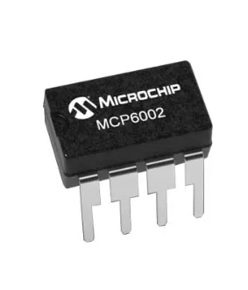
Hardware – Schematics
MCP 6002
Gain = 2
6

Slide 10
Hardware – Schematics
Filter
@ 1.5 KHz
7

Slide 11

Hardware – Schematics
Capacitive Moisture Sensor
(already conditioned)
8

Slide 12
Development of a Plant Assist System
03
Software

Slide 13
Firmware – Arduino
Sampling of the signal
Comparison
of the data with a threshold
Data from the sensors is acquired every second
Activation of the actuators
Switching on and off LED strips
Switching on a LED
To guarantee the proper
amount of light
An LED signals whether the soil is dry or humid
9

Slide 14
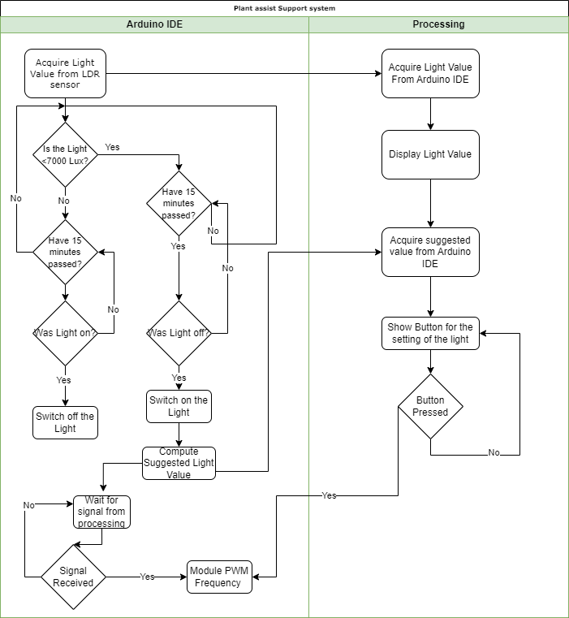
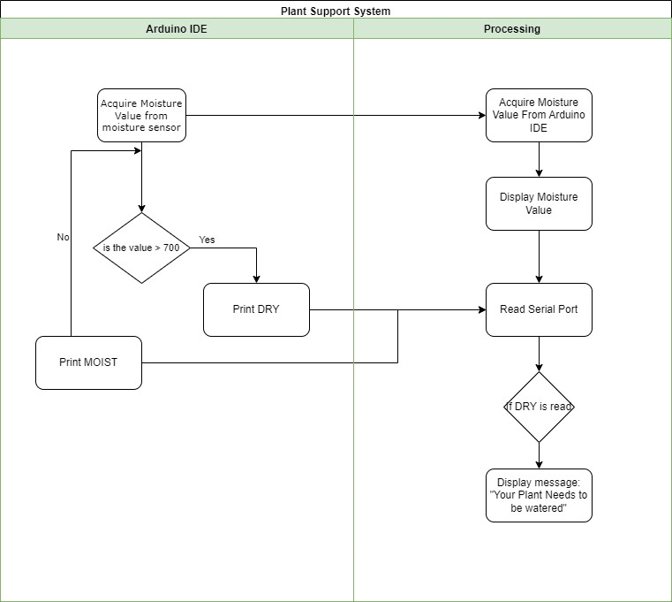
Arduino – Flowcharts
10

Slide 15
Arduino – Flowcharts
to Processing
11

Slide 16
Arduino – Flowcharts
from Processing
12

Slide 17
Arduino – Flowcharts

Slide 18
Arduino – Flowcharts
to Processing
to Processing
13

Slide 19
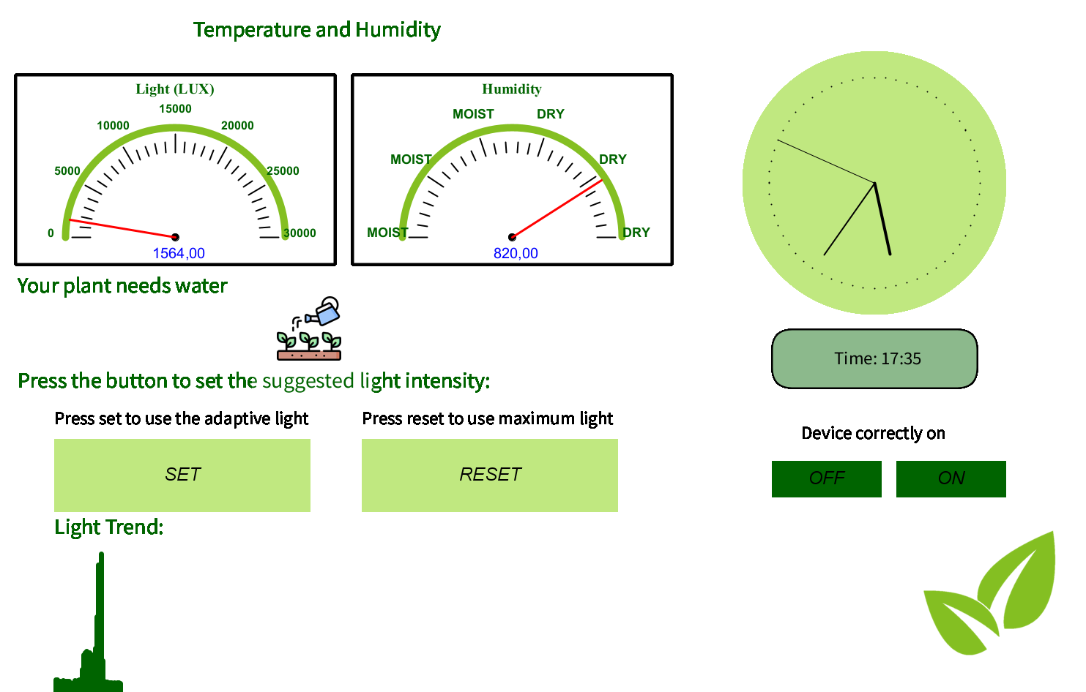



User Interface - Processing
Real Time Data
Processing acquires data from Arduino and displays their real time variation
Notifications
Processing notifies the user in case the moisture sensor acquires a DRY value to water the plant
Control
Through the PWM function in Arduino we suggest a specific intensity value for the user to set, according to the last measurements to reduce energy consumption and maximize efficiency
14

Slide 20
Development of a Plant Assist System
04
Automatized Lighting

Slide 21
Automatized Lighting
Signal from an Arduino digital pin
Mosfet Module
A 24V battery provides the alimentation for the load
LED strips
15

Slide 22
Development of a Plant Assist System
05
3-D Structure

Slide 23

3-D Structure
16

Slide 24
Development of a Plant Assist System
06
Future Perspectives

Slide 25
Future Perspectives
Connecting lights to the electrical main
Adding a water pump
It automatically irrigates the plant when required
To guarantee that lights stay switched on for a longer time
17

Slide 26
Development of a Plant Assist System
Thank you for your attention

